Slide 1
MCTS Guide to Microsoft Windows 7
Chapter 8
Networking

Slide 2
Objectives
Understand Windows 7 network components
Understand Windows 7 network architecture
Describe and configure Internet Protocol version 4
Describe and configure Internet Protocol version 6
Perform and monitor file sharing
Connect Windows 7 to the Internet
Describe and configure wireless networking
Configure Windows Firewall
Describe network bridging
Describe ad hoc and homegroup networks

Slide 3
Networking Overview
Basic components of Windows 7 that support networking
Network and Sharing Center
Networks
Connections

Slide 4
Network and Sharing Center
Network and Sharing Center
Central point in Windows 7 for managing the configuration of the network you are connected to
Areas
Network map
Active Network details
Change your networking settings

Slide 5
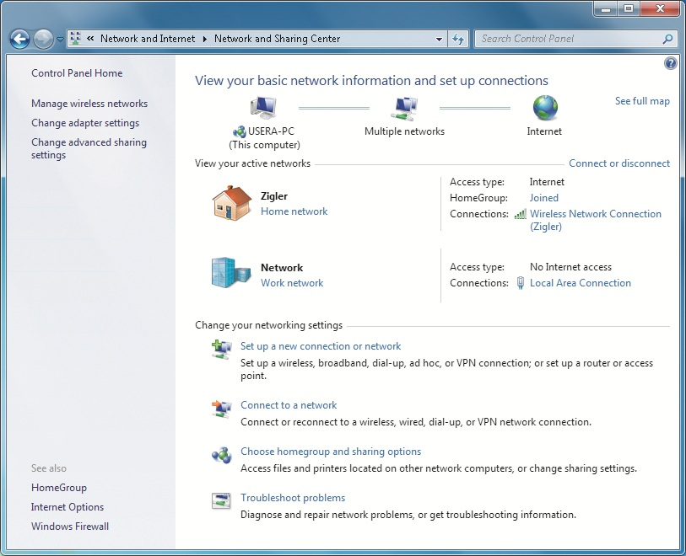
Network and Sharing Center Window

Slide 6
Networks
Network location awareness
Allows you to configure the security settings for each location type differently
Configuration settings for each location type are saved
Network Management
View and manage all of the network locations your computer has connected to

Slide 7
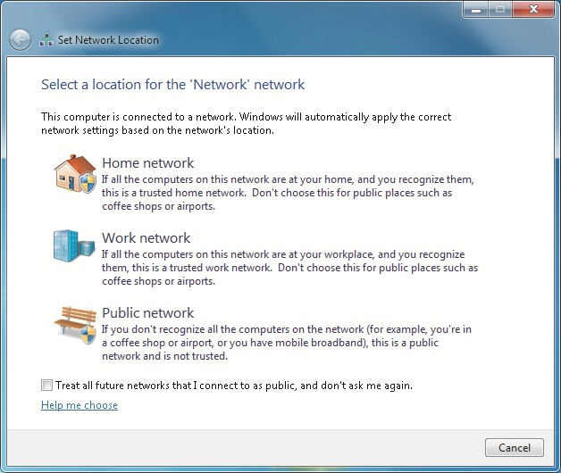
Networks Location Types

Slide 8
Networks (cont'd.)
Network Discovery
Provides you with an easy way to control how your computer views other computers on the network
Advertises its presence on the network
Options
Turn on network discovery
Turn off network discovery

Slide 9
Connections
For each network device installed in your computer
Connection is created to manage that network device
Clients and services
Applications that use the network to communicate
Client allows you to connect to a particular service running on a remote computer
Service allows your computer to accept connections from and provide resources to a remote computer

Slide 10
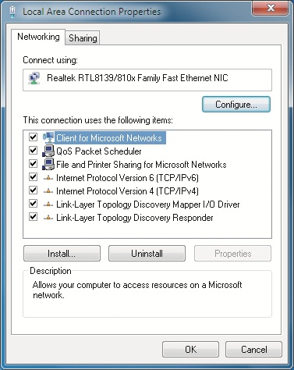
Area Connection Properties Dialog Box

Slide 11
Connections (cont'd.)
Local Area Connection Properties
Clients and services included with Windows 7
Client for Microsoft Networks
File and Printer Sharing for Microsoft Networks
QoS Packet Scheduler
Both the Client for Microsoft Networks and File and Printer Sharing for Microsoft Networks
Use Server Message Block (SMB) version 2.0 protocol

Slide 12
Connections (cont'd.)
Protocols
Rules for communicating across the network
Define how much data can be sent and the format of the data as it crosses the network
Protocols supported by Windows 7
Internet Protocol Version 4 (TCP/IPv4)
Internet Protocol Version 6 (TCP/IPv6)
Link-Layer Topology Discovery Mapper I/O Driver
Link-Layer Topology Discovery Responder
Network driver
Responsible for enabling communication between Windows 7 and a network device in your computer

Slide 13
Network Architecture
Windows 7 includes several interfaces
Make it easier for developers to create clients, services, protocols, and network drivers
Interfaces for networking in Windows 7
Windows Sockets (Winsock) user mode
Transport Device Interface (TDI)
Winsock Kernel (WSK)
Network Driver Interface Specification (NDIS)

Slide 14
IP Version 4
Important configuration concepts of IPv4
IP addresses
Subnet masks
Default gateways
DNS
WINS
Methods for configuring IP
Troubleshooting IPv4

Slide 15
IP Addresses
Each computer must have a unique IP address to communicate on the network
IP addresses are most commonly displayed in dotted decimal notation
Several ranges of IP addresses are reserved for internal network use
A proxy server or network address translation (NAT) must be used
Provides Internet access to computers using these addresses

Slide 16
IP Addresses (cont'd.)
Addresses for internal networks
IP Address Range | Network ( in CIDR notation)
192.168.0.0– 192.168.255.255 | 192.168.0.0/ 16
172.16.0.0– 172.31.255.255 | 172.16.0.0/ 12
10.0.0.0– 10.255.255.255 | 10.0.0.0/ 8

Slide 17
Subnet Masks
IP address is composed of a network ID and a host ID
Subnet mask
Defines which part of an IP address is the network ID and which part of the IP address is the host ID

Slide 18
Default Gateways
Routers
Control movement of packets through networks
Default gateway
A router on the local network that is used to deliver packets to a remote network

Slide 19
DNS
Domain Name System (DNS)
Essential to communicate on a TCP/IP network
Resolves host names to IP addresses
DNS is essential for Internet connectivity because most people use domain names, not IP addresses
Accesses Internet servers such as Web sites

Slide 20
WINS
Windows Internet Naming Service (WINS)
Used to resolve NetBIOS names to IP addresses
Stores information about services such as domain controllers
WINS is primarily used for backward compatibility with older NetBIOS based networks

Slide 21
Methods for Configuring IP
To configure IP, you can use:
Static configuration
Dynamic configuration
APIPA
Alternate IP configuration
Scripts
Dynamic Host Configuration Protocol (DHCP)
An automated mechanism used to assign:
IP addresses, subnet masks, default gateways, DNS servers, WINS servers, and other IP configuration information to network devices

Slide 22
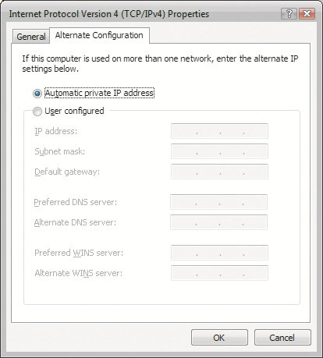
Methods for Configuring IP (cont'd.)

Slide 23
Methods for Configuring IP (cont'd.)
Automatic Private IP Addressing (APIPA) address
Addresses on the 169.254.0.0/16 network
Designed as a solution for very small networks with no Internet connectivity requirements
Windows 7 also allows you to configure a static set of alternate IP configuration options
If a DHCP server cannot be contacted, the alternate IP configuration is used instead

Slide 24
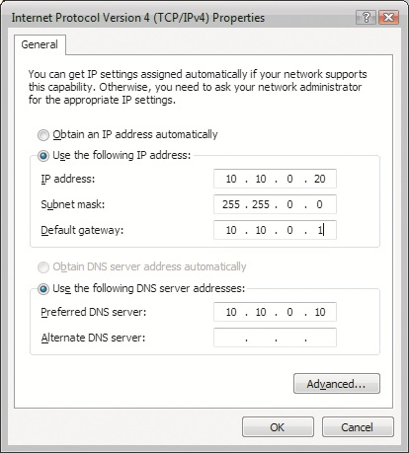
Methods for Configuring IP (cont'd.)

Slide 25
Essential IPv4 Utilities
Hostname command
Displays host name of the computer that it is run on
ipconfig command
Displays the basic TCP/IP settings of all active network connections
ping command
Confirms basic IP connectivity between the computer that it is run on and a specified target host
tracert command
Details an IP path through routers to a destination IP address

Slide 26
Essential IPv4 Utilities (cont’d.)
pathping command
Combines the functionality of the ping and tracert commands
route command
Alters or display the IP routing table
netstat command
Displays different types of TCP/IP statistics for active software and connections
nbtstat command
Displays information about a connection using NBT

Slide 27
Essential IPv4 Utilities (cont’d.)
getmac command
Identifies the MAC address assigned to each adapter in the system
arp command
Identifies the MAC addresses of computers that can directly communicate with the computer
netsh command
Powerful script tool that can view or modify the computer’s network configuration
nslookup command
Used at the command prompt to lookup a DNS entry

Slide 28
Troubleshooting IPv4
Confirm current settings
ipconfig and netsh utilities can display the current settings
Validate IPv4 connectivity
ping utility can be used to confirm that the computer can ping its own loopback address
Verify DNS name resolution
Confirm the correct DNS servers are specified on network settings
Verify data connections
Problem may be a result of data filtering by a firewall

Slide 29
IP version 6
Improvements found in IPv6 include:
Increased address space
Hierarchical routing to reduce the load on Internet backbone routers
Simpler configuration through automatic address management
Inclusion of encryption services for data security
Quality of service
Extensibility to support new features

Slide 30
IPv6 Address Notation
Address space for IPv4 is nearing depletion
IPv6 has a significantly larger address space
IPv6 addresses are 128 bits long
IPv6 has many more addresses than would normally be required for computing devices
IPv6 addresses are represented in hexadecimal, with each four-digit segment separated by colons
Any group of four hex digits can drop leading zeros
Long set of zeros can be compressed to a double colon

Slide 31
IPv6 Address Types
Link-local Unicast
Allows computers in a local network to communicate with each other without requiring the use of a router
Global Unicast
Can be routed as a public address on the Internet through routers and networks
Unique Local Unicast
Replacement address type for the deprecated site-local address type

Slide 32
IPv6 Address Types (cont’d.)
Multicast
Serves the same purpose as an IPv4 multicast address
Anycast
Multiple devices can share the same anycast address and respond to other computers without an IP address conflict
Special addresses
Two special addresses exist in IPv6, the loopback address and the unspecified address

Slide 33
IPv6 Address Types (cont’d.)
Teredo
Allows IPv6 data to be tunneled over an IPv4 network that is using Network Address Translation (NAT).

Slide 34
Methods for Configuring IPv6
Windows 7 automatically configures its network interfaces with a link-local address
To configure IPv6, you can use:
Static configuration
Automatic configuration
Scripts

Slide 35
Troubleshooting IPv6 Settings
Confirm current settings
Settings should be confirmed due to the default nature of IPv6 clients attempting to auto-configure themselves
Validate IPv6 connectivity
ping utility can be used to confirm that the computer can ping its own loopback address
Verify DNS name resolution
Verify data connections
Using the telnet application is a common tool for administrators to test application connectivity

Slide 36
File Sharing
File sharing in Windows 7
Allows you to share files from any folder on your computer or the Public folder
With other computer users on your LAN

Slide 37
Sharing the Public Folder
Sharing the Public folder
Simplified way to perform file sharing
Files in the Public folder are shared between users who log on the local computer
Can also be shared with network users
Options for sharing the Public folder
Turn on sharing so anyone with network access can read and write files in the Public folder
Turn off Public folder sharing

Slide 38
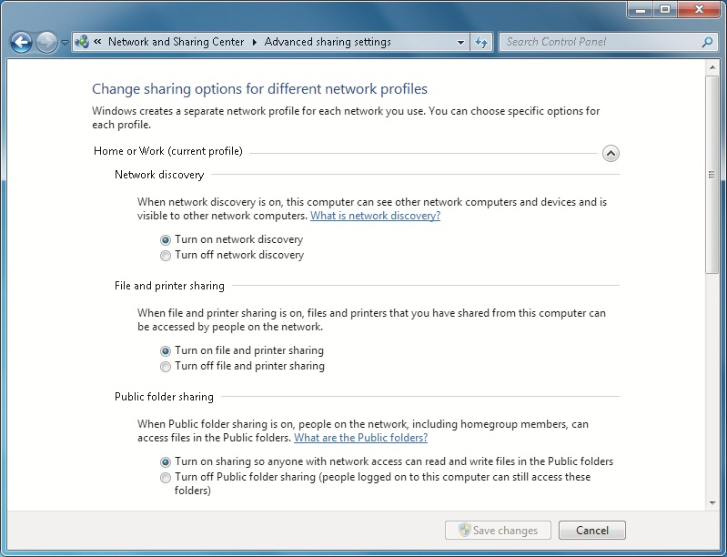
Sharing the Public Folder (cont'd.)

Slide 39
Sharing the Public Folder (cont'd.)
Options for Password protected sharing related to the Public folder
Turn on password protected sharing
Turn off password protected sharing

Slide 40
Sharing Any Folder
Sharing files from any folder on your computer
Gives you more options to control
Which users have access to your files
What those users can do to your files
You can set the permissions for users when you share individual folders
Ability to configure permissions may be confusing for inexperienced users
In a domain-based network
Can select users from the domain to share files with

Slide 41
Sharing Any Folder (cont'd.)
In a workgroup-based network
You must create local accounts for the users you want to share files with

Slide 42
Creating and Managing Shared Folders
“Share with” menu option
Simplifies folder sharing by controlling both NTFS permissions and share permissions at the same time
Choices in the Share with menu
Nobody
Homegroup (Read)
Homegroup (Read/Write)
Specific people

Slide 43
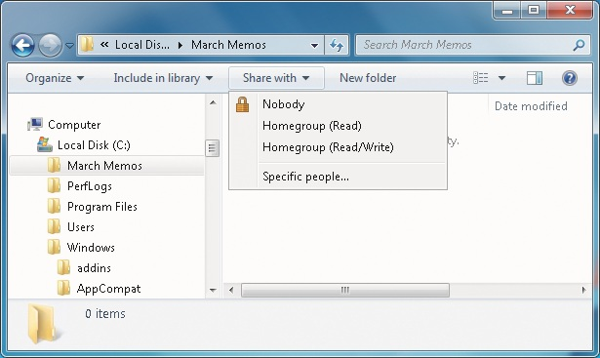
Creating and Managing Shared Folders (cont'd.)

Slide 44
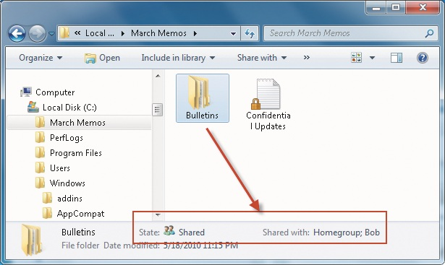
Creating and Managing Shared Folders (cont'd.)

Slide 45
Creating and Managing Shared Folders (cont'd.)
Advanced Sharing
Allows you to configure options that are not available in the simpler “Share with” interface
Only configures share permissions
When shared folder permissions are combined with NTFS permissions
Most restrictive permissions are effective
To simplify the management of permissions
Assign Full Control share permission to the Everyone group
Use NTFS permissions to control access to the files

Slide 46
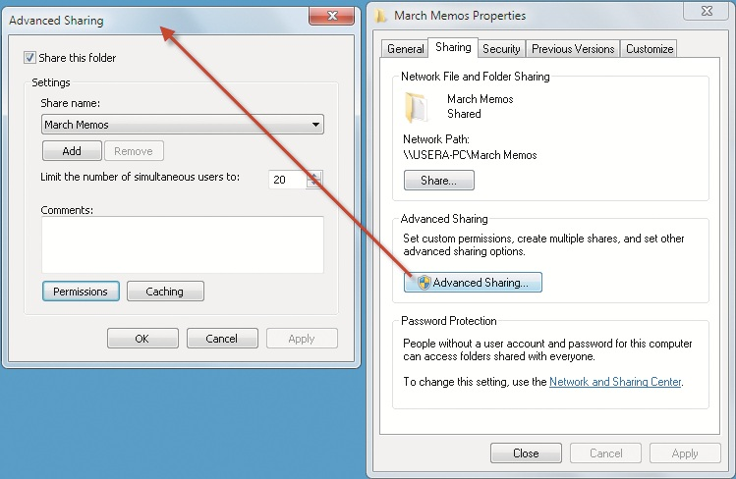
Creating and Managing Shared Folders (cont'd.)

Slide 47
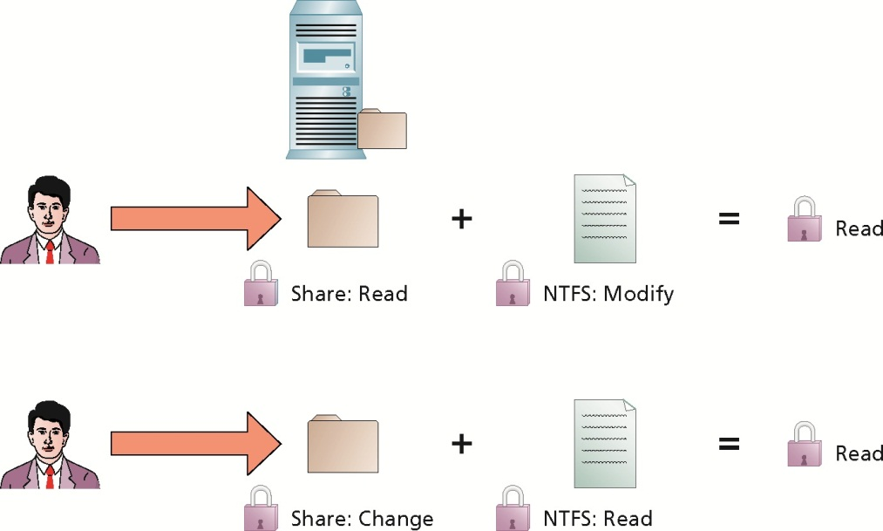
Creating and Managing Shared Folders (cont'd.)

Slide 48
Creating and Managing Shared Folders (cont'd.)
Advanced Sharing (cont'd.)
Settings you can configure in Advanced Sharing
Share this folder
Share name
Limit the number of simultaneous users to
Comments
Permissions
Caching
Share permissions available in Windows 7
Full Control
Change
Read

Slide 49
Monitoring Shared Folders
Computer Management
Most comprehensive way to monitor shares
Shared Folders System Tool has three nodes for monitoring and managing shared folders
Shares
Sessions
Open Files

Slide 50
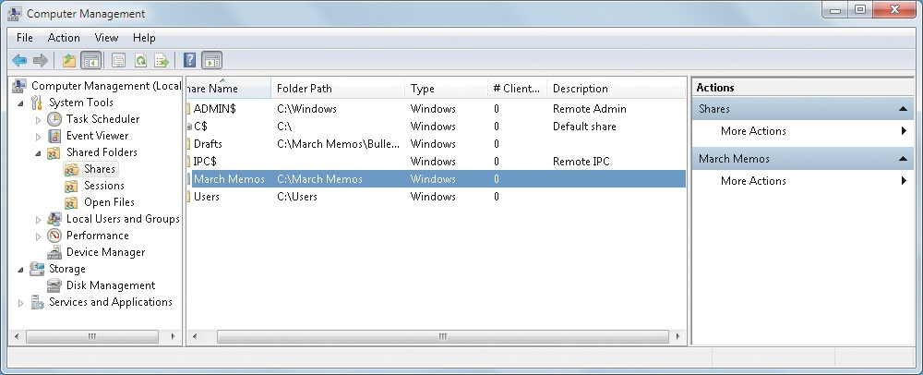
Monitoring Shared Folders (cont'd.)

Slide 51
Internet Connectivity
Topics
Single-Computer Internet Connectivity
Shared Internet Connectivity
Internet Connection Sharing

Slide 52
Single-Computer Internet Connectivity
Cable
Almost all cable companies offer high-speed Internet connectivity
You will be supplied with a cable modem
By default, Windows 7 networking is configured to use DHCP to obtain IP configuration information
Digital subscriber line (DSL)
High-speed Internet connection over telephone lines
You will be supplied with a DSL modem
Usually use Point-to-Point Protocol over Ethernet (PPPoE) to secure connection

Slide 53
Single-Computer Internet Connectivity (cont’d.)
Dial-Up
Much slower way to access the Internet
Suitable for simple tasks such as reading e-mail and text-oriented Web pages
Wireless WAN
Fully supported by Windows 7
Most broadband vendors refer to this feature as “tethering” the computer to the mobile device

Slide 54
Shared Internet Connectivity
Multiple computers can share a single Internet connection
Common for cable modem and DSL connections
Common mechanisms for sharing an IP address
Router
Internet Connection Sharing (ICS)
Router or computer performing ICS is assigned the IP address from the ISP
Computers on the internal network are assigned private IP addresses

Slide 55
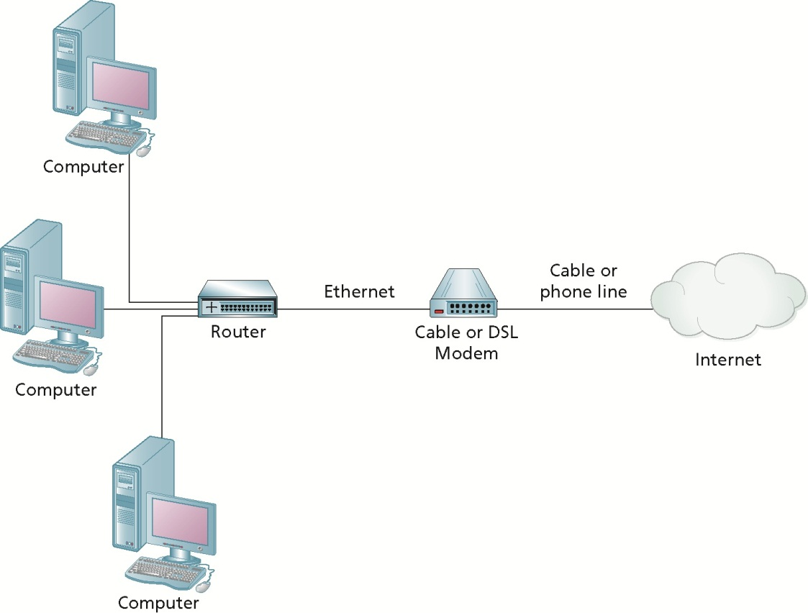
Shared Internet Connectivity (cont'd.)

Slide 56
Shared Internet Connectivity (cont'd.)
Hardware routers sold in retail stores
Simple firewalls that perform network address translation (NAT)
NAT is the process that allows multiple computers to share a single IP address
ICS also performs NAT

Slide 57
Internet Connection Sharing
ICS allows a Windows 7 computer to act as an Internet router
Called the host computer
Host computer must have an Internet connection (public interface)
Plus one additional network connection (private interface)
Use the Sharing tab in the Properties of the public interface to enable ICS

Slide 58
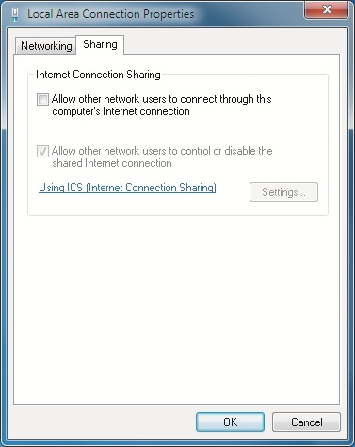
Internet Connection Sharing (cont'd.)

Slide 59
Wireless Networking
Wireless network
Transfers data without a physical connection
Windows 7 provides a strong foundation for wireless technology
Wireless access point (WAP)
Base station that connects to the wired network
Most common configuration details for a WAP:
Security Set Identifier (SSID)
802.11 mode
Security method

Slide 60
Creating a Wireless Connection
Several methods:
Manually connect to a wireless network
Connect to a Network
Copy profile from USB flash drive
Command line
Group policy

Slide 61
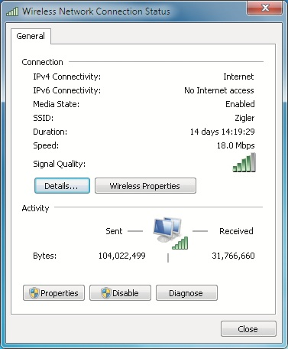
Managing Wireless Connections

Slide 62
Troubleshooting Wireless Connections
Other devices, such as microwaves and cordless telephones, can interfere with the signal
Some 802.11 standards are limited to what channels, in addition to specific frequencies, they can use to communicate
Windows 7 client can be configured to connect to a WAP automatically when it is in range
WAP devices in public places may be untrusted, even if they have a pass-phrase configured

Slide 63
Windows Firewall
Windows 7 includes an improved version of Windows Firewall to protect your computer
Standard firewall
Protects your computer by restricting which network packets are allowed to reach your computer
Host-based firewall
Evaluates each packet as it arrives and determines whether that packet is allowed or denied
One way to improve security on computers is by reducing the attack surface

Slide 64
Windows Firewall (cont'd.)
Windows Firewall features
Inbound filtering
Outbound filtering
Firewall rules combined with IPsec rules
Support for complex rules
Support for logging

Slide 65
Basic Firewall Configuration
Windows Firewall Control Panel window
Windows 7 allows custom firewall settings for each type of network location: home, work, or public
When Windows Firewall is enabled
Default configuration blocks all incoming packets except for specifically configured exceptions
There is an option to block all incoming connections

Slide 66
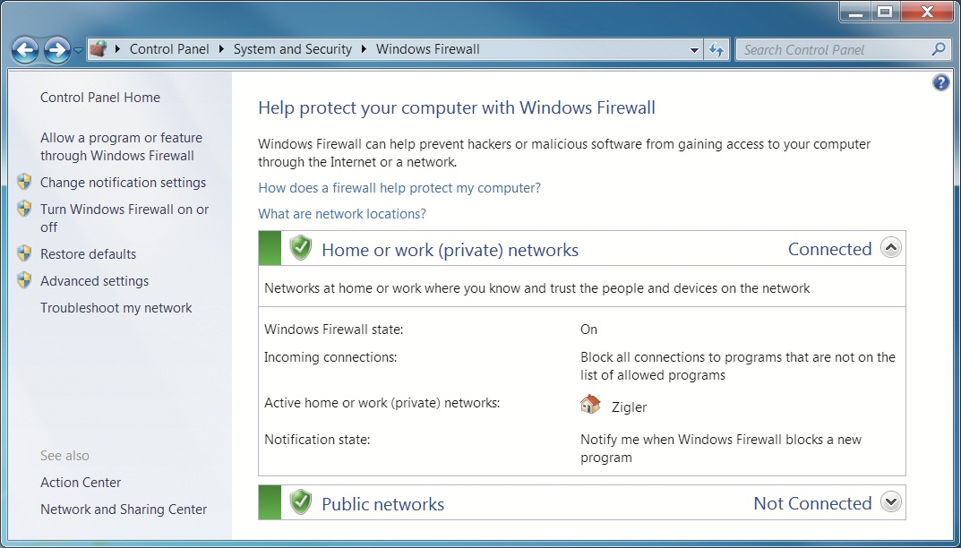
Basic Firewall Configuration (cont'd.)

Slide 67
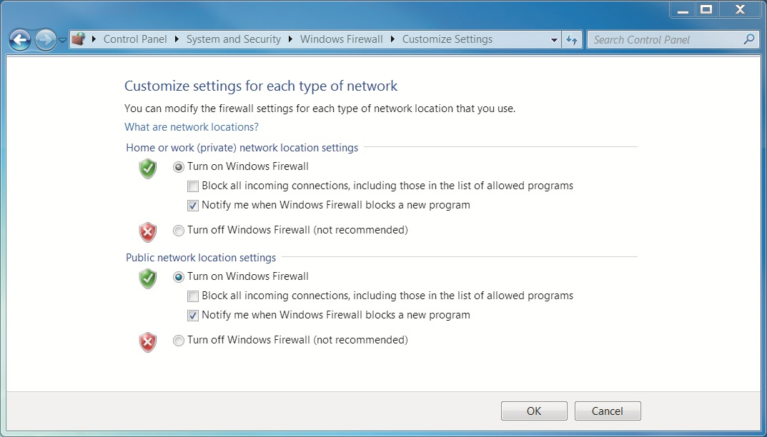
Basic Firewall Configuration (cont'd.)

Slide 68
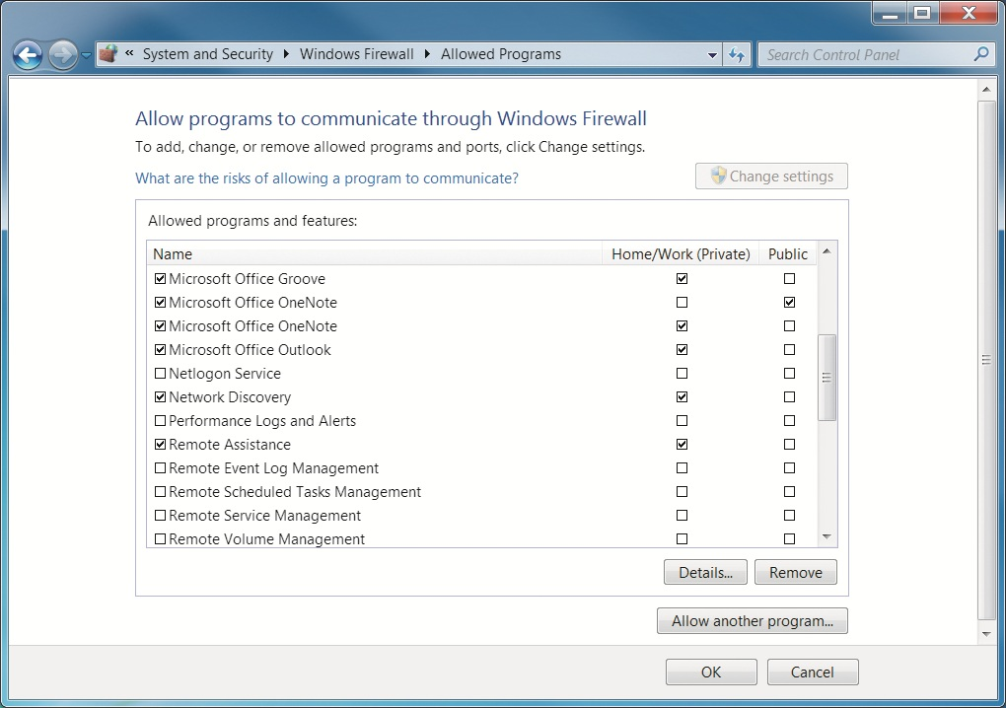
Basic Firewall Configuration (cont'd.)

Slide 69
Advanced Firewall Configuration
Allows you to configure more complex rules, outgoing filtering, and IPsec rules
Tools available to perform advanced firewall configuration
Windows Firewall and Advanced Security snap-in
Netsh
Group Policy
Configure Firewall Properties
Windows 7 stores the firewall properties based on location types

Slide 70
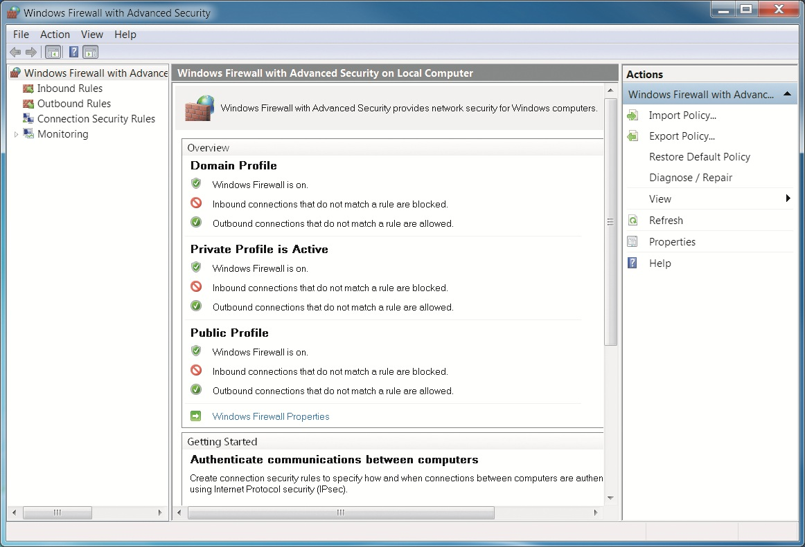
Advanced Firewall Configuration (cont'd.)

Slide 71
Advanced Firewall Configuration (cont'd.)
Configure Firewall Properties (cont'd.)
Configuration of each location type is called a profile
Windows Firewall with Advanced Security on Local Computer node
Shows the configuration of each profile
In each profile, you can:
Enable or disable Windows Firewall
Configure inbound connections
Configure outbound connections
Customize settings
Customize logging

Slide 72
Advanced Firewall Configuration (cont'd.)
Configure Firewall Properties (cont'd.)
IPsec is a system for securing and authenticating IP-based network connections
IPsec settings you can configure
Key exchange
Data protection
Authentication Method
A large number of inbound and outbound rules are created by default in Windows 7

Slide 73
Advanced Firewall Configuration (cont'd.)
You modify an existing rule by opening its properties
Tabs in the properties of an outbound rule
General
Programs and Services
Computers
Protocols and Ports
Scope
Advanced

Slide 74
Advanced Firewall Configuration (cont'd.)
Create New Firewall Rules
A wizard guides you through the process
Rule types you can create with the Outbound Rule Wizard
Program
Port
Predefined
Custom
Actions for a rule
Allow the connection
Allow the connection if it is secure
Block the connection

Slide 75
Advanced Firewall Configuration (cont'd.)
Create New Computer-Connection Security Rules
Use IPsec to authenticate and secure communication between two computers
Security rule types
Isolation
Authentication exemption
Server-to-server
Tunnel
Custom

Slide 76
Advanced Firewall Configuration (cont'd.)
Monitor Windows Firewall Rules and Connections
Firewall node under Monitoring in the Windows Firewall with Advanced Security snap-in
Allows you to see rules that are enabled in one screen
Connection Security node under Monitoring
Allows you to see the computer connection security rules that are enabled
And any security associations that are active
Security association
Rules for communication between two computers

Slide 77
Network Bridging
Network bridge in Windows 7
Allows you to connect two separate networks, with Windows 7 acting as a bridge between them
Networks can be of different types
Computer acting as a network bridge must have two network cards to connect to each network
Technology is seldom used

Slide 78
Ad hoc and Homegroup Networks
Networking for a small group of computers outside the corporate office is more about convenience
Two networking technologies that assist with that goal
Ad hoc networking
Homegroups

Slide 79
Ad hoc Networking
Ad hoc network in Windows 7
Allows you to configure an existing wireless network adapter on your computer as a rudimentary wireless access point (WAP)
Options and features are limited in comparison to a commercial WAP

Slide 80
Homegroup Networks
Primarily uses IPv6 and link-local addresses to enable communications between homegroup members
Discovery of computers and their names on the local network is automatic by default
Computer can only create a homegroup when it has a network interface connected as a home network location and it is not domain joined
Security in a homegroup is simple
Windows automatically manages homegroup connections

Slide 81
Summary
Network Sharing Center is a central location to view and access networking information
Windows 7 is network-aware and can sense which network location it is connected to
Network connections are composed of clients, services, protocols, and drivers
Windows 7 network architecture includes Winsock, TDI, and WSK interfaces
Important configuration concepts in IPv4 are IP addresses, subnet masks, default gateways, DNS, and WINS

Slide 82
Summary (cont'd.)
Windows 7 can obtain IP configuration information from static configuration data, DHCP, APIPA, or an alternate IP configuration
Windows 7 uses IPv6 to support peer-to-peer networking applications
Sharing the Public folder is an easy way to share files on the network
When you share any folder you can use “Share with” or advanced sharing

Slide 83
Summary (cont'd.)
The primary technologies for connecting to the Internet are cable, DSL, and dial-up
With ICS, there must be a mechanism to share the single IP address assigned by your ISP
Windows Firewall is a host-based firewall included with Windows 7
Network Bridging lets you connect two different network types as a single network
Ad hoc networks allow a Windows 7 computer to configure its wireless network adapter as a basic wireless access point

